Slide 1
TRAFFIC MANAGEMENT
OBJECTIVE :-
The objective of traffic management is to ensure the safe and efficient movement of vehicles, pedestrians, and other road users on the transportation network. It aims to minimize congestion, reduce travel times, enhance road safety, and improve overall transportation system performance. Traffic management strategies include traffic flow optimization, congestion management, intelligent transportation systems, public transportation improvements, and promoting sustainable modes of travel.

Slide 2
SPECIFICATIONS
Traffic signals and signs
Traffic flow optimization
Intelligent Transportation Systems (ITS)
Road Maintenance
Public Transportation Facilities
Pedestrian and Cyclist Safety
Emergency Response
Environmental Considerations

Slide 3
Compliance and Regulation
•Traffic Data Collection
CIRCUIT diagram and explanation:-
Creating a detailed traffic management circuit diagram requires specific software tools designed for circuit design, such as AutoCAD, Eagle, or online platforms like Fritzing. These tools allow you to create intricate circuit diagrams with symbols representing different components and connections.

Slide 4
As a text-based AI, I cannot draw diagrams directly. However, I can guide you on how to create a basic traffic management circuit diagram
Represent traffic lights using appropriate symbols (usually colored circles) to indicate red, yellow, and green lights.

Slide 5
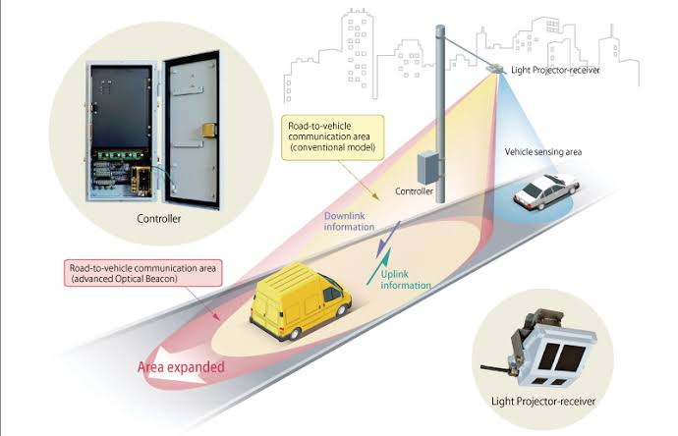
WORKING AND EXPLINATION:-
Traffic flow sensors are devices used to monitor and collect data about vehicular traffic on roads. They play a crucial role in traffic management systems

Slide 6
These sensors are embedded in the road surface at intersections or traffic lanes. They detect the presence of vehicles by measuring changes in inductance when a vehicle passes over the loop. Inductive loop sensors are commonly used in traffic light control systems.
Infrared sensors use infrared beams to detect the presence of vehicles. When a vehicle passes through the infrared beam, it interrupts the signal, indicating the presence of a vehicle.

Slide 7
Creating a block diagram for a traffic flow sensor system involves representing the key components and their interconnections. Here's a simplified block diagram for a traffic flow sensor system

Slide 8
+-----------------------------------------+
| Traffic Flow Sensor System |
+-----------------------------------------+
|
+---------+---------+
| |
v v
+-----------------+ +-----------------+
| Vehicle | | Data Processing |
| Detection | | and Analysis |
| Sensors | | System |
| (Inductive, | | (Microcontroller,|
| Infrared, Radar,| | DSP, Computer) |
| Video Cameras, | | |
| etc.) | | |
+-----------------+ +-----------------+
|
v
+-----------------+
| Communication |
| Interface |
| (Wired/Wireless,|
| Ethernet, CAN, |
| etc.) |
+-----------------+
|
v
+-----------------+
| Traffic Control |
| Center |
| (Traffic Lights,|
| Message Signs, |
| etc.) |
+-----------------+

Slide 9
const int irSensorPin = 2; // Pin connected to the infrared sensor
int vehicleCount = 0; // Variable to store vehicle count
void setup() {
Serial.begin(9600); // Initialize serial communication at 9600 baud rate
pinMode(irSensorPin, INPUT); // Set IR sensor pin as input
}
void loop() {
int sensorValue = digitalRead(irSensorPin); // Read sensor value (HIGH or LOW)
if (sensorValue == HIGH) {
// Vehicle detected
vehicleCount++;
Serial.println("Vehicle Detected! Count: " + String(vehicleCount));
delay(1000); // Delay to avoid counting the same vehicle multiple times
}
// Send vehicle count data to the central control center via Serial
Serial.print("Vehicles: ");
Serial.println(vehicleCount);
// Add additional code here to send data to a central control center using communication protocols like UART, Wi-Fi, or GSM.
delay(100); // Delay between sensor readings
}

Slide 10
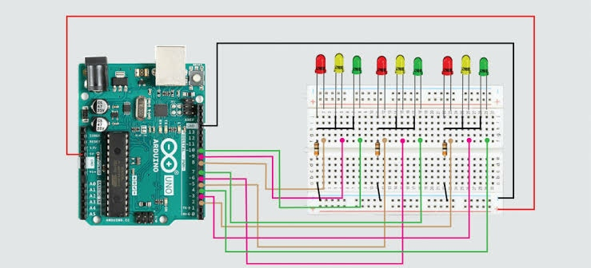
CIRCUIT DIAGRAM:-

Slide 11
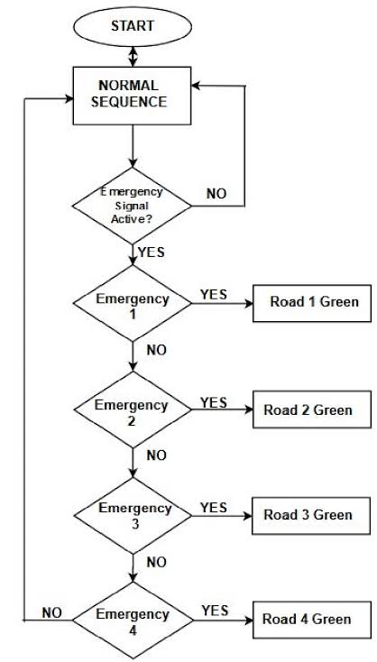
BLOCK DIAGRAM

Slide 12
APPLICATION:-
•Parking Management
Emergency Vehicle Priority
Air Quality Monitoring
Data Analytics for Decision Making
Public Transportation Optimization

Slide 13
CONCLUSION
In conclusion, traffic management plays a pivotal role in creating efficient, safe, and sustainable transportation systems. By leveraging advanced technologies such as sensors, data analytics, and smart algorithms, traffic management systems can optimize traffic flow, reduce congestion, enhance road safety, and improve overall mobilit

